Slide 1
Développement de l’hypophyse
Lobe intermédiaire
Fente de Rathke
Notes:
FIGURE 18–1 Diagrammatic outline of the formation of the pituitary (left) and the various parts of the organ in the adult (right).

Slide 2
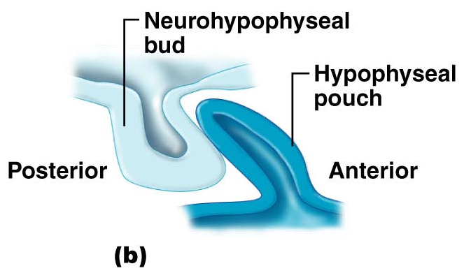
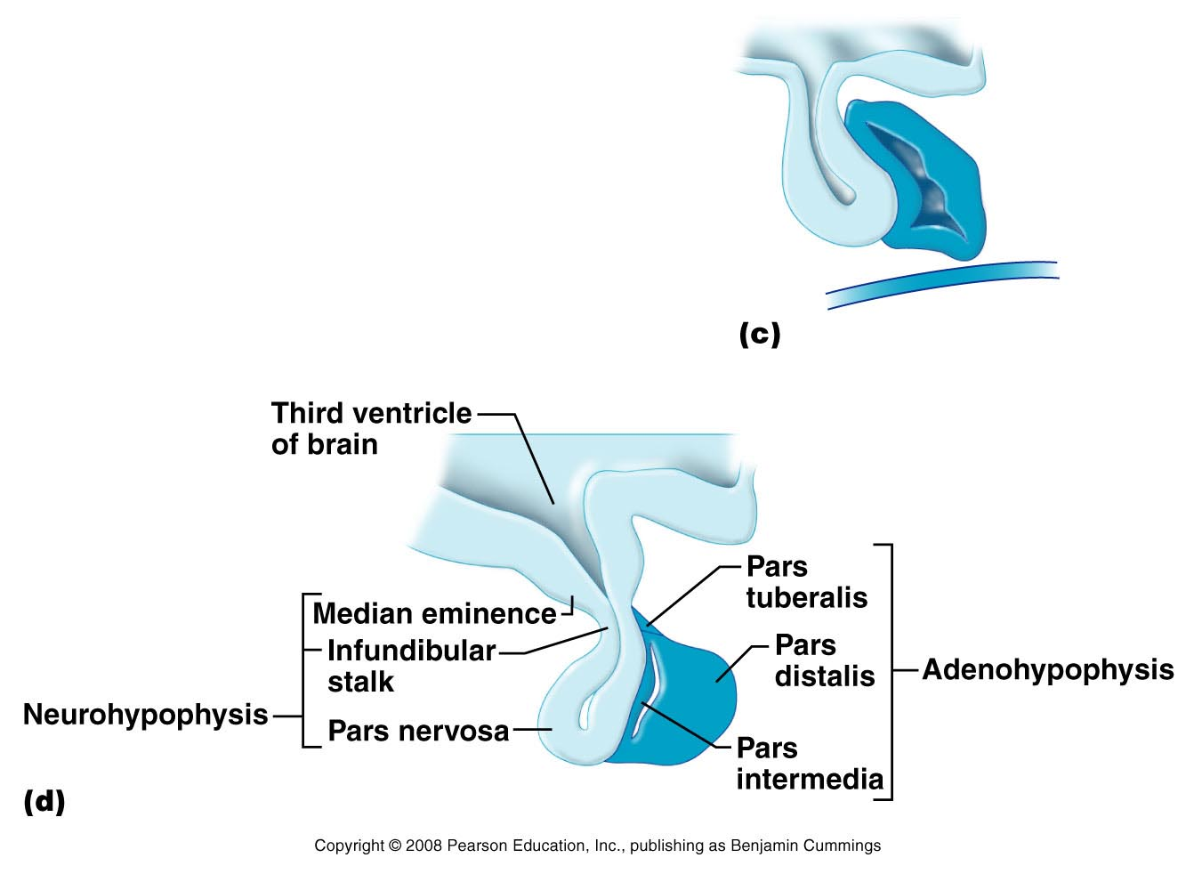
Développement
de l’hypophyse
Notes:
Marieb Figure 25.13c, d

Slide 3
Développement de l’hypophyse

Slide 4
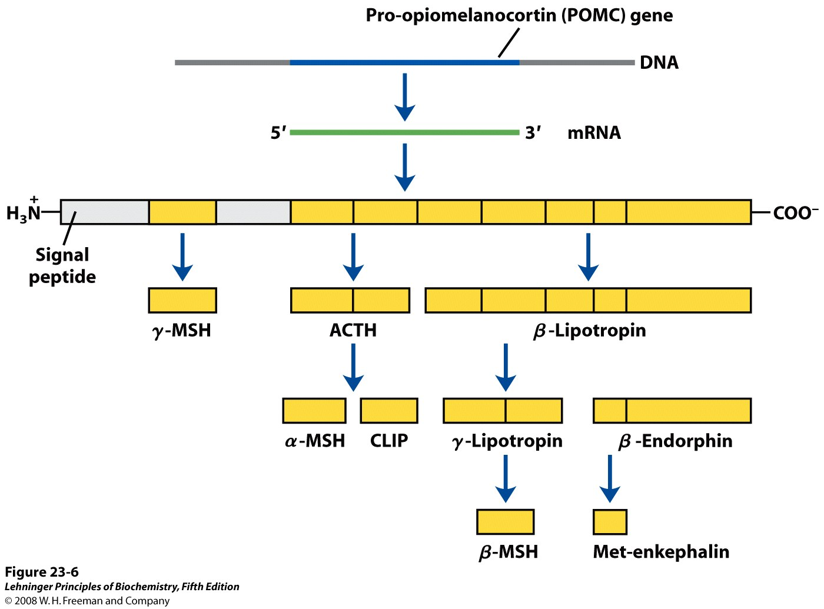
39 a.a.
90 a.a.
MSH = melanocyte-stimulating hormone,
(or melanocortin)
Notes:
FIGURE 23-6 Proteolytic processing of the pro-opiomelanocortin (POMC) precursor.
The initial gene product of the POMC gene is a long polypeptide that undergoes cleavage by a series of specific proteases to produce
ACTH, β- and γ-lipotropin, α-, β-, and γ-MSH (melanocyte-stimulating hormone, or melanocortin), CLIP (corticotropin-like intermediary peptide), β-endorphin, and Metenkephalin.
The points of cleavage are paired basic residues, Arg–Lys, Lys–Arg, or Lys–Lys.

Slide 5
AL = Lobe Antérieur
IL = Lobe Intermédiaire
!
22 a.a.
Notes:
Ganong

Slide 6
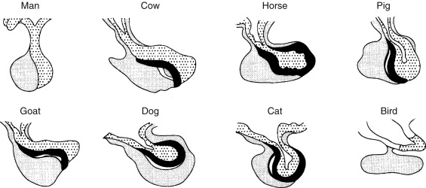
The posterior wall of Rathke's pouch is closely apposed to the neural tissue of the NL, thereby forming
the intermediate lobe (IL), which is well developed in most mammals, but not in humans and birds (Fig. 18.2).
In humans only during fetal life is a distinct IL found (Amar and Weiss, 2003).
https://www.sciencedirect.com/topics/agricultural-and-biological-sciences/rathkes-pouch

Slide 7
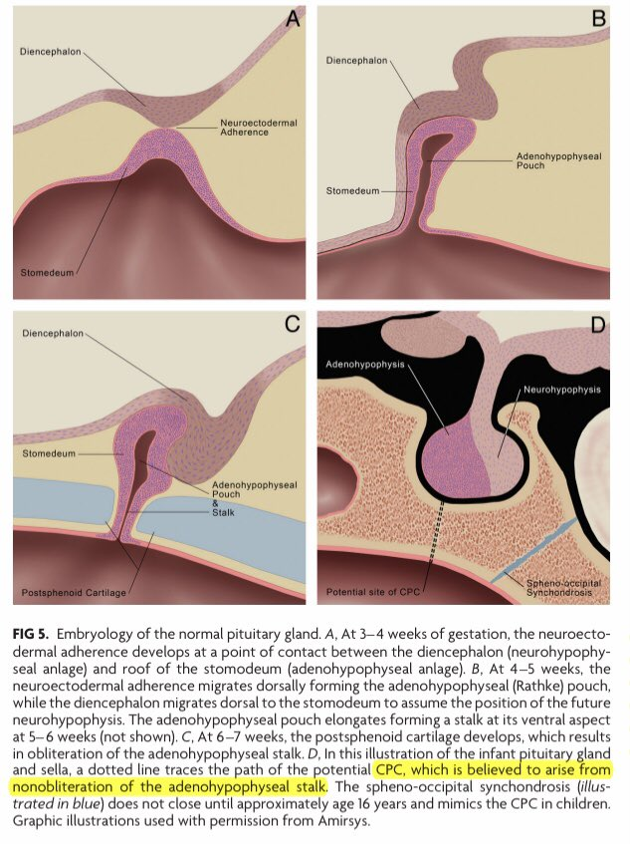
stomodeum

Slide 8
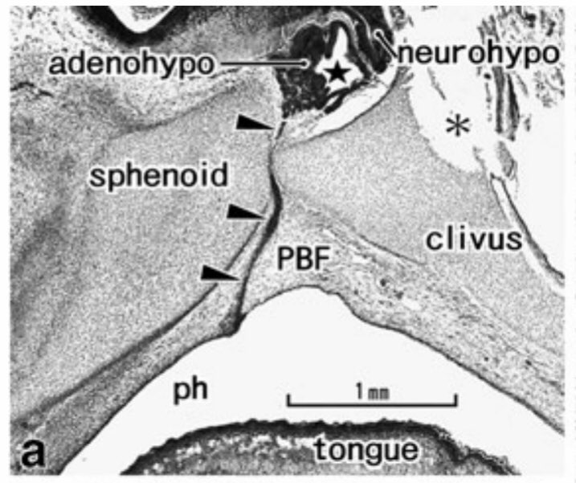
Canal
crânio-pharyngien

Slide 9
Notes:
148-314 hypophyse.jpg

